Slide 1
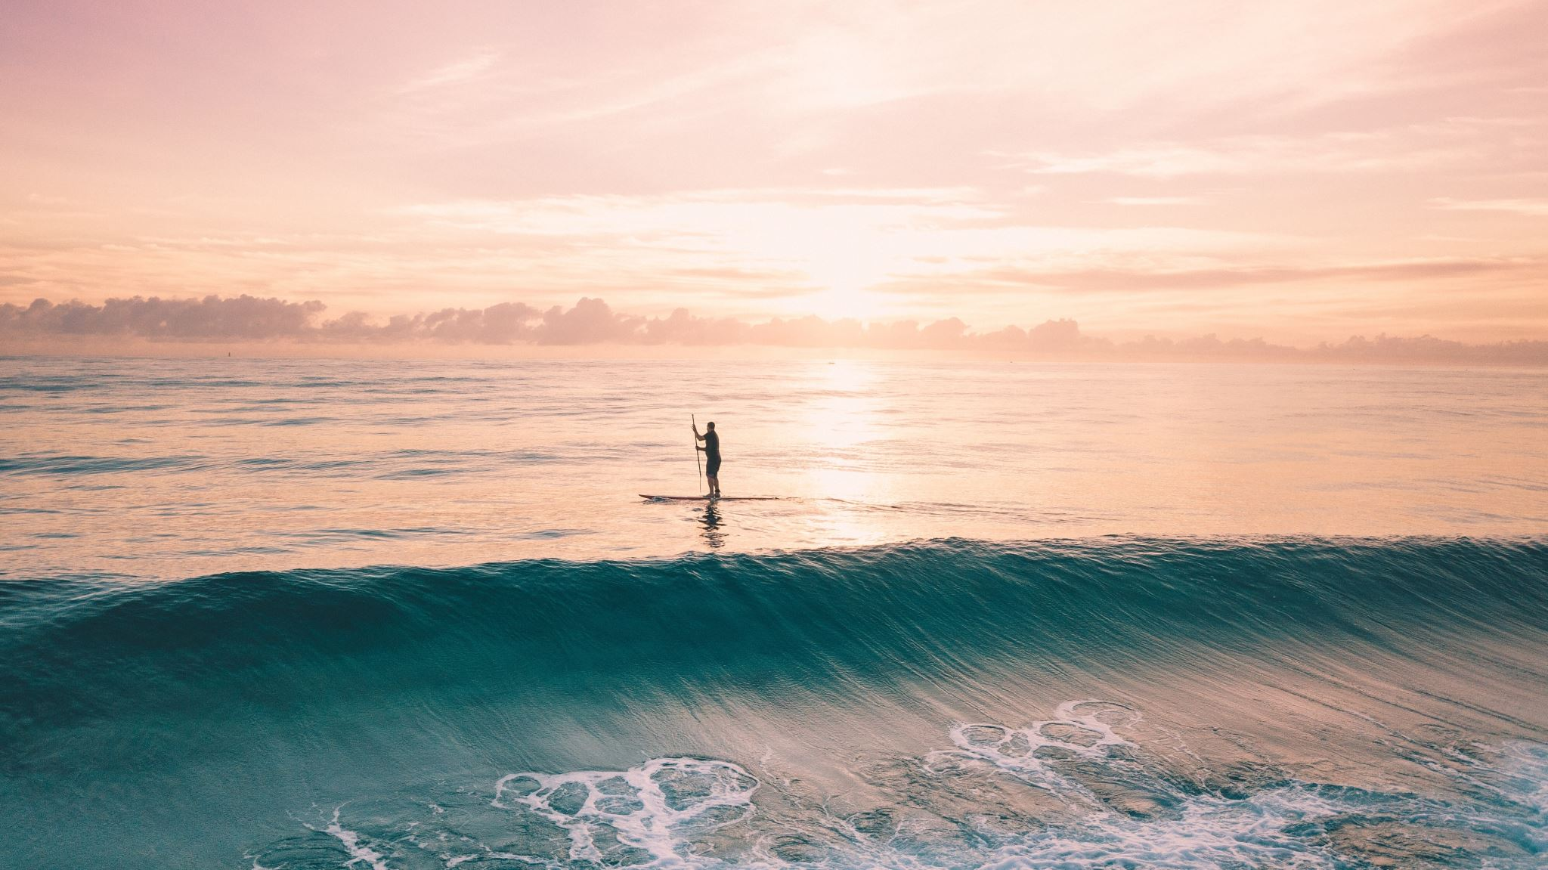
Clark News
Week Ending 5/15

Slide 2
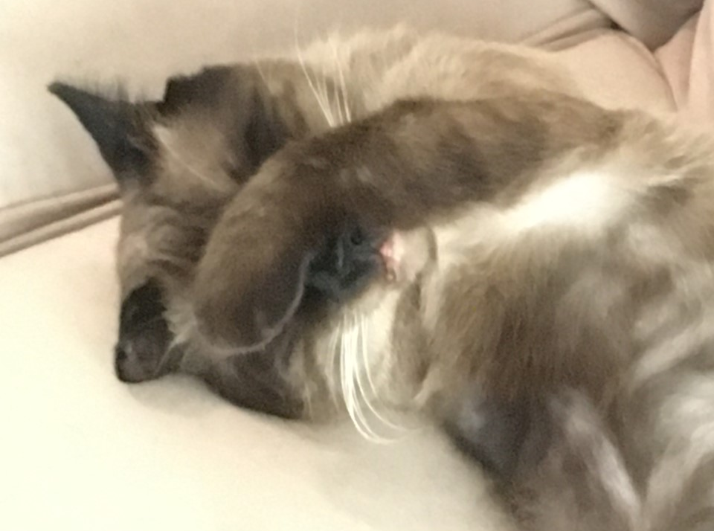
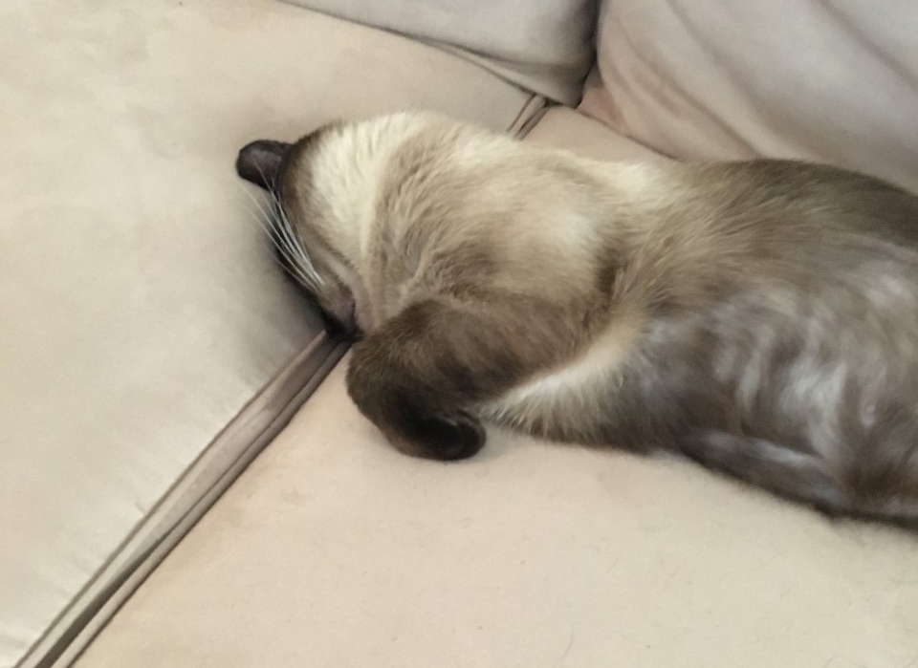
My cat expresses it best!
Please keep checking emails regularly through end of May (and all summer!)

Slide 3
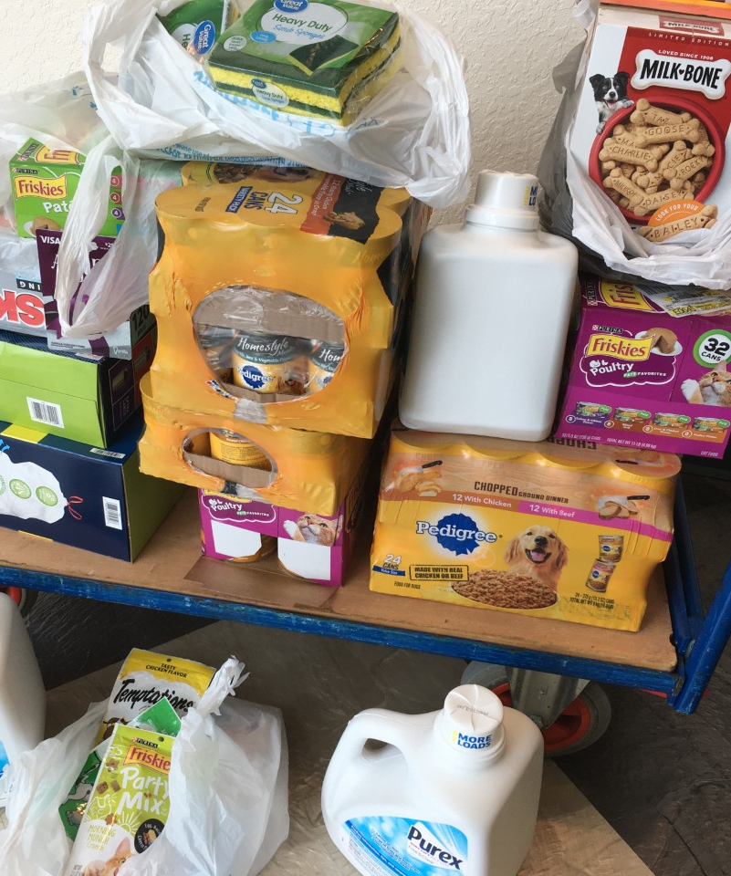
Shout outs
Brandon Gunter for massive profit in the StockMarket game used in Econ class…even in these tough times!
Mrs. Bartow for sharing with colleagues some tips in google classroom.
Jagger Sturdivant- Furry Friends collection success!
Everyone who has made their appointment for next week!

Slide 4
Returning and Picking Stuff Up
We need to minimize all trips and time on campus, so please try to gather ALL you can for one trip (seniors will have 2). It is IMPERATIVE you make an appt.
Make your appointment here
Textbook returns
Laptop returns
Yearbook
Diplomas & more senior goodies (after Memorial Day). Link to be sent to seniors.

Slide 5
Checking out checklist!
Student Check-Out at APPOINTMENT TIME ONLY
Be prepared with the following ---
BRING YOUR OWN PEN for form completion
Laptop Return
  Laptop with no stickers
  Laptop cord wrapped
  Any issues that need repair or attention - be prepared to fill out form
OR Laptop Purchase ---> check or cash for $250 OR Bill of Sale showing payment
Textbooks to return?
  If lost, email sdecker@irsc.edu to know replacement cost / check or cash
Yearbook to pick up?
Awards or Senior Regalia to pick up?
Any other questions or concerns?

Slide 6
Announcements
Follow us on Social Media- Search Clark Advanced Learning Center on Facebook and Instagram.
Pet supply drive continues.
Yesterday’s awards assembly here. Mrs. Gribble art here.
Keep Bingo cards coming in!
$80 yearbooks agribble@irsc.edu

Slide 7
More Announcements
Summer Program at FOS https://www.floridaocean.org/summer-teen-ambassador-program
Tech savvy and graphic designers– great opportunity with MCSD. Learn more and apply here.
UWorld is offering FREE 90-day access to our SAT and ACT exam preparation products for all of your high school students. Students can activate their subscription anytime between now and June 15, 2020. https://bit.ly/3dIRakm

Slide 8
Class of 2020
Seniors- fill out the link for your post HS plans and where to send your final transcripts here.
Save the date! July 25, 2020 at 9:00 am
Virtual celebration May 23, 2020 at 10:00 am

Slide 9
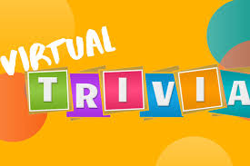
Virtual Trivia!
The Clark Computer Science Club is proud to host a virtual trivia game to celebrate the end of the term and kick off the summer! This event will be held in Blackboard Collaborate (link TBA) on Thursday, May 21 at 1:00 PM. Please plan to attend!
Email sfears@irsc.edu to sign up and the link to join will be shared with you.

Slide 10
May is Mental Health Month
Over HALF of our students finished ALL of the mental health modules by the prize deadline of 5/14.
Another approximately 25% are ALMOST done.
Everyone needs to finish before next Thursday, 5/21.
  Website- https://martin.suite360sel.org/360admin/login?return=360admin
  Username = clark email address
  Password is 4300 number

Slide 11
Coral Shores Program

Slide 12
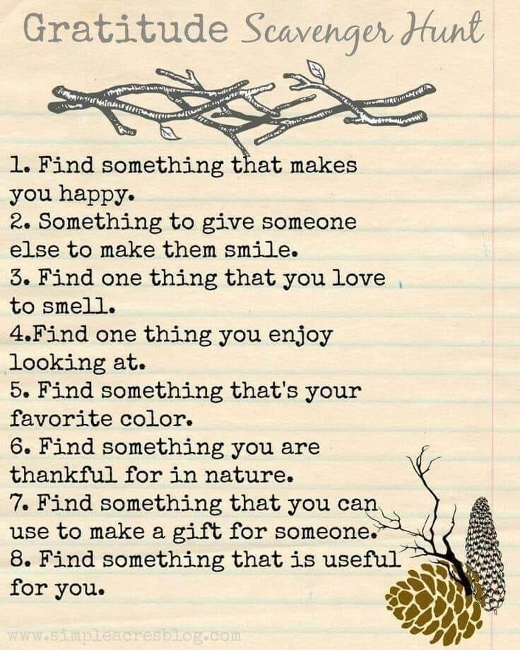


Slide 13
Mrs. Kohuth’s song of the week
Barry Manilow - When The Good Times Come Again
https://www.youtube.com/watch?v=YGE9UBprFUo
Hope we both survive the world out there
You'll never know what wind will blow
So don't forget I care
And don't forget the way we felt together
Sometimes we have to hold
To all the good that's been

Slide 14
Adulting- Communication!!!
Oops- so tired I forgot to add one last week!
Top 10 Cell Phone Rules: https://emilypost.com/advice/top-ten-cell-phone-manners/
Telephone Skills: https://www.youtube.com/watch?v=Nq65EmDpBA0
Email Etiquette: https://www.youtube.com/watch?v=-0N1RE0C4vk
How to Address an Envelope: https://www.youtube.com/watch?v=7I7c67KM4FA
Hand-written communication — thank you notes, cards, letters: https://www.youtube.com/watch?v=sDrEWEI2PuA
Handshake etiquette Around the World: https://www.youtube.com/watch?v=x2dGVrOtDtw
The 7 Habits of Highly Effective People Summary: https://www.youtube.com/watch?v=WFc08j9eorQ
Powerful Passwords: https://www.youtube.com/watch?v=IhlXtBNNuKs

