Slide 1
Veterans Day
11/11/2018

Slide 2
History of
Veterans Day originated as “Armistice Day” on Nov. 11, 1919, the first anniversary of the end of World War I. Congress passed a resolution in 1926 for an annual observance, and Nov. 11 became a national holiday beginning in 1938.
This marks the 100th year of the end WWI

Slide 3
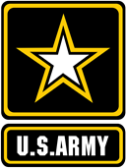
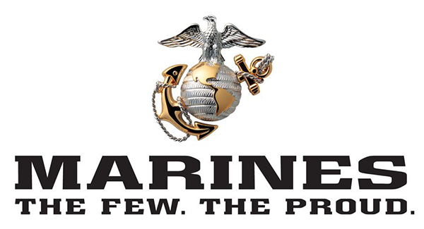
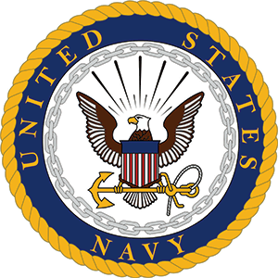
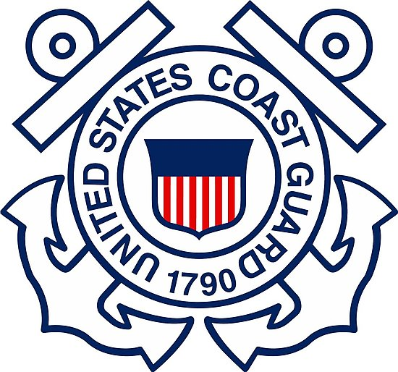
Welcome to our recruiters!
SFC Rebekah Gray: Army
SFC Coty Benson: Army
TSGT Kevin Neiferd: Air Force
SSGT Melvin McKnight: Marines

Slide 4
Clark Family Veterans
We are pleased to have Veterans and families of Veterans here at Clark.

Slide 5
Mr. Fears
Went through Basic Training and was at the Air Force Academy. He shares that his time in the military had a significant impact on the way he teaches and lives his life.

Slide 6
Jason Ravanzo, US Army.
Captain
Served 4 years as a physician.
Derek Ravanzo’s father

Slide 7
Deb Ravanzo, US Army
Captain
Served 4 years as an Air Defense officer with the Patriot Missile System and two years as a Military Intelligence officer.
Derek Ravanzo’s mother

Slide 8
Jim Elkins, US Navy
Petty Officer 2nd class
I was in about 6 years total. 2 tours to the Persian gulf and went to at least 29 countries. I was stationed mostly out of Charleston SC on the USS MacDonough DDG 39 guided Missile destroyer. My rate was Gunners Mate Missile (GMM) where I held an above top secret clearance.
I was also assigned to the following ships & duty stations
USS Fulton (AS-11) Quincy Ship Yard MA
USS Albacore (AGSS-569) Portsmouth Naval Shipyard NH
Weapons handler Naval Submarine Base New London CT

Slide 9
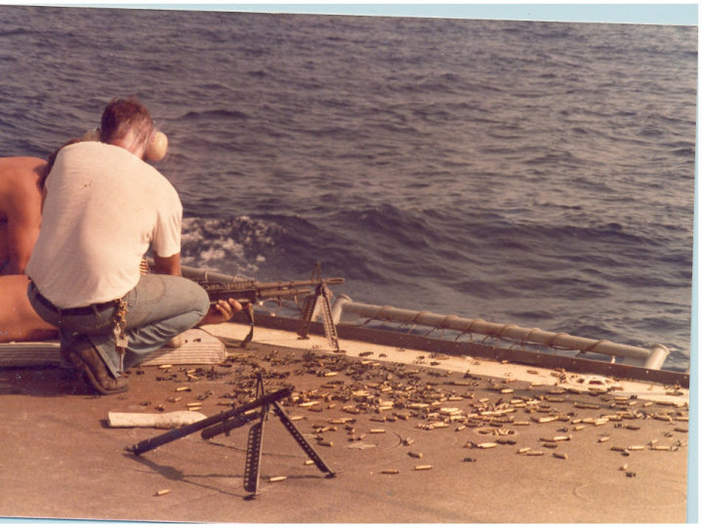
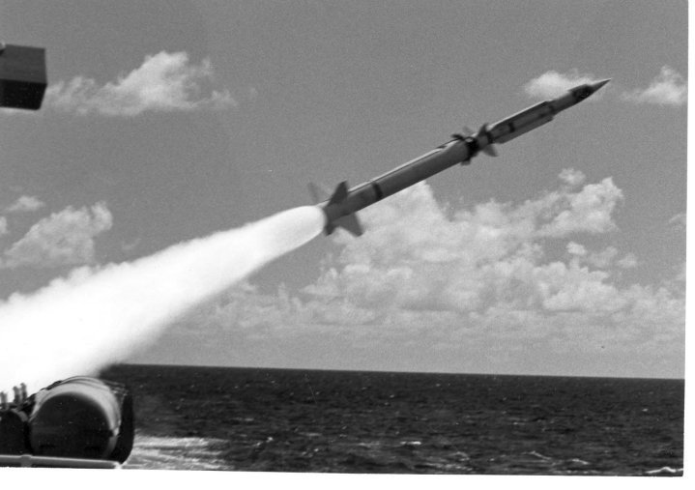
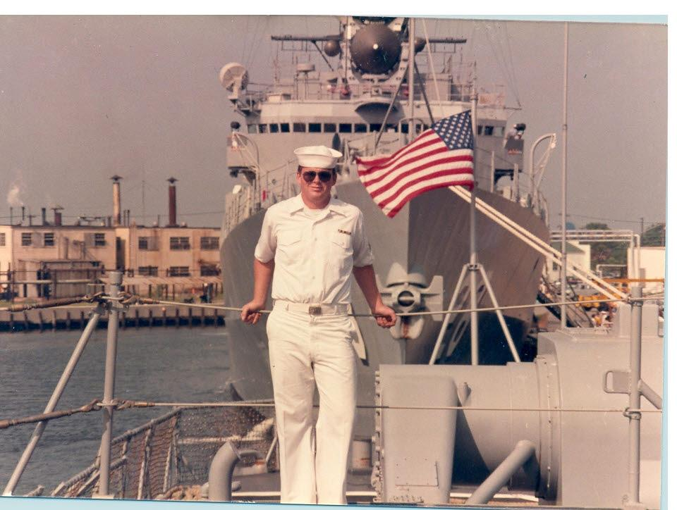
The ship is DDG 39 MacDonough AKA Big Mac
The helicopter is how we reload food and other supplies while underway, literally 3 of these would drop off 3 to 5 fully loaded pallets dropping off a new load every 2 minutes and could go on for 4 to 5 hours straight.
The machine gun is an M60 light .30 caliber weapon being shot in the Persian Gulf.
The missile pictures are of a SM2 Terrier (A newer version of these are still used in the fleet today)

Slide 10
Staff Sgt. Derek Miller, US army
Mr. Bicksler’s stepson.
He is currently at Fort Indiantown Gap in Pennsylvania.
He has served deployments in Iraq twice and in Qatar. He has also served in Korea and as a part of the Army running team. His US stations have included Fort Riley, Kansas, Fort Carson in Colorado, Fort Sill in Oklahoma, and Fort Bliss in El Paso, Texas.

Slide 11
Sergeant Nicolas A. Escandon, US Army National Guard
Mr. Escandon’s brother
11 years in New Mexico. He was deployed to Iraq from March 2008 to May 2010.

Slide 12
Sergeant Antonio F. Escandon, Florida National Guard
Currently in the Reserve.
He was deployed to Germany in 2008.

Slide 13
Walter Judd, Sr.
Mr. Judd’s father
WWII vet. He fought in the Pacific in several battles including Iwo Jima. I remember him telling me that he saw the flag raising, both times. Also pulled occupation duty in Japan including Hiroshima.

Slide 14
Tim Edwards, US Marine Corps
Sergeant
Served 1999-2004
Aviation maintenance on F-18s
Served on the USS Roosevelt for 159 days with no sight of land. Called the Iron man Cruise as it was the longest out to sea since WWII (Indian Ocean). In support of Operation Enduring Freedom. Departed 9/17/01 and they were the first squadron to strike against terror.
Land based during Iraqi Freedom in 2003 (Kuwait and Iraq)

Slide 15
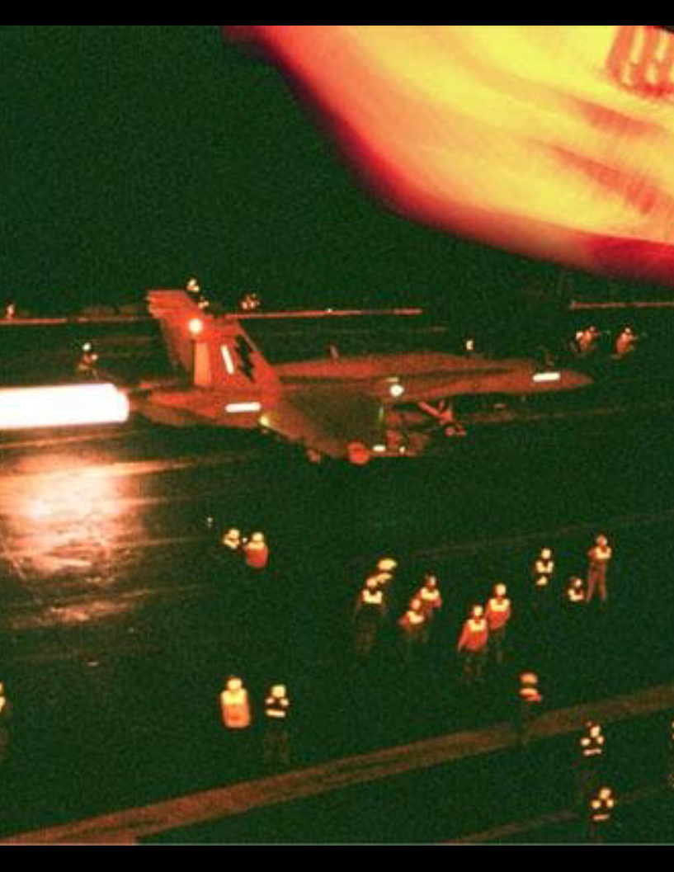
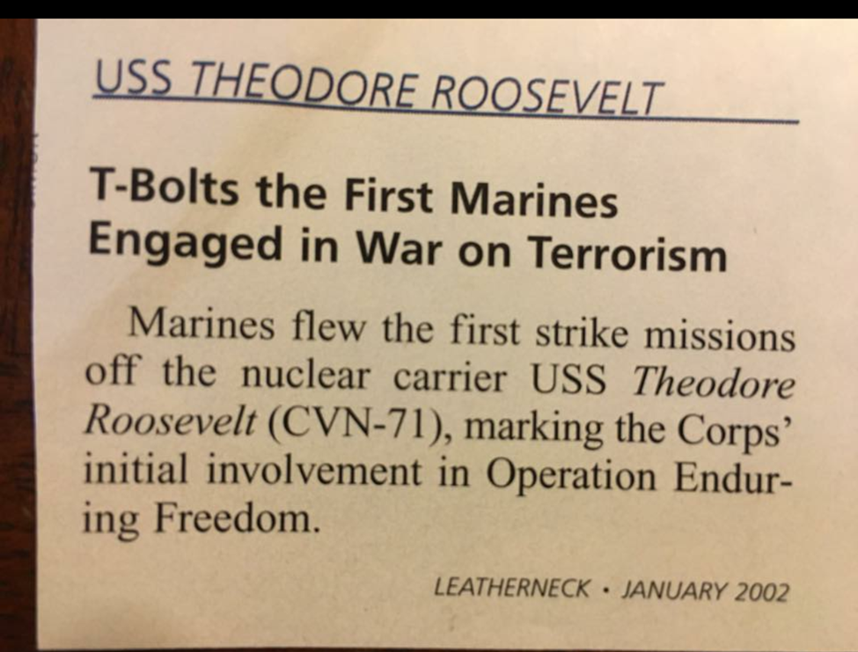

Slide 16
James F. Carlisle, US Army
Olivia Salem’s uncle
Just retired from the army after over 30 years of service.
Now that he is retired he is dedicated his time to teaching in the underprivileged schools of South Carolina. He has a passion for teaching and inspiring youth.

Slide 17
Robert Wright, US Air Force
Captain (1993-1997)
A section commander and executive officer to the squadron commander and then later the executive officer to the group commander for a combat -ready fighting force. My last commander was the top commander of the USAF (General Mark E. Welsh)

Slide 18
Donna Johnson, Army/National Guard
Guard/1988-1992 enlisted in the Connecticut guard while in college
Also did ROTC
When to Desert Storm as a combat medic and was in charge of a medical ward near the front
Received my commission as a 2nd Lieutenant and served as a medical field officer
Mallory Johnson’s mother

Slide 19
Don Knauf, Army/National Guard
1957-1991
Retired as a General
Worked a lot with recruiting
Mallory Johnson’s grandfather

Slide 20
QUESTIONS
What inspired you to join the military, how did your loved ones feel about you joining?
How did you stay in touch with your family, were you able to contact them often?
Do you recall the day your service ended, what was it finally like to be back home?

Slide 21
Semper Fi Fund
The Semper Fi Fund is one of America’s highest rated charities and are dedicated to providing needed resources and support to predominately post 9/11 combat wounded, critically ill, and catastrophically injured members of the U.S. Armed Forces and their families.
They apply their donations to comprehensive, proven programs that deliver immediate and long-lasting impact. They ensure service members have the resources they need during their recovery and throughout transition back to their communities.
The Semper Fi Fund has raised over $150 million in assistance to service members of all branches of the Armed Forces.

